Slide 1
Kickstarting
Competitive Programming!
https://tinyurl.com/jhtf86bz

Slide 2
What is Competitive Programming?
Mind sport
Logical or mathematical problems
Judging is based on numbers of questions solved in limited time:
Limited time for the contest
Limited time for your program to run through data & give results

Slide 3
Why Should I Participate?
Solve hard problems in a more elegant and readable fashion
Better at dealing real-world application problems
An opportunity to explore different algorithms and data structures

Slide 4
Google Kickstart
Initially a test for Google to hire its employees
6 online rounds

Slide 5
Format
3 hours, 3-4 questions each round
Subparts of different difficulty levels
No limit on the language used (We will use Python 3 for this workshop, though C++ is often recommended as it is faster)
No limit on number of submissions & results will be shown once submitted.

Slide 6
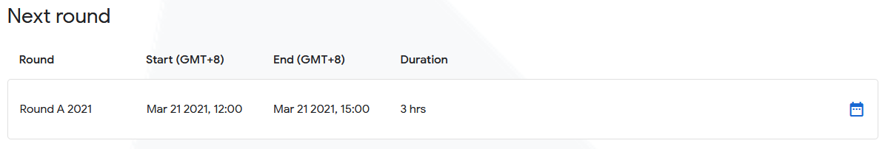

Slide 7
Let’s Start with a Simple Question

Slide 8
Kickstart 2020 Round A, Allocation
https://codingcompetitions.withgoogle.com/kickstart/round/000000000019ffc7/00000000001d3f56#problem

Slide 9
Kickstart 2020 Round A, Allocation
Problem
There are N houses for sale. The i-th house costs A_{i} dollars to buy. You have a budget of B dollars to spend.
What is the maximum number of houses you can buy?

Slide 10
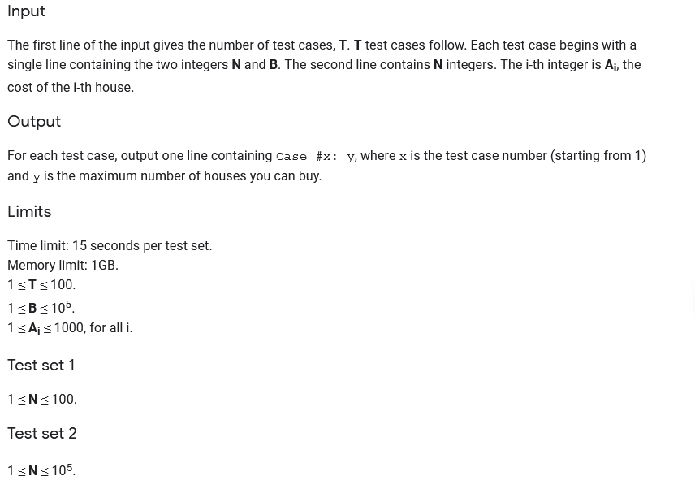
Input, Output Format & Limit

Slide 11
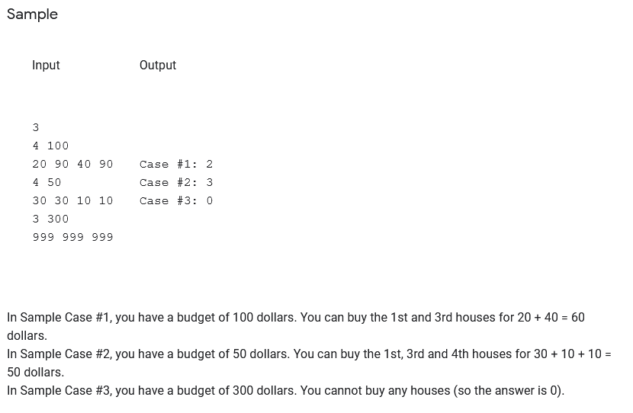
An example with explanation

Slide 12
Analysis - Greedy
We want to buy as many as possible houses. Intuitively, we can keep buying the cheapest house. The rationale is to save money at each step so we could buy more in the end. One way to implement this strategy is to sort all the houses by prices from low to high and then buy houses one by one until we run out of money.

Slide 13
Solution
Input & Formatting of data
Algorithm
Output of Result

Slide 14
Kickstart 2020 Round B, Bike Tour
https://codingcompetitions.withgoogle.com/kickstart/round/000000000019ffc8/00000000002d82e6#problem

Slide 15
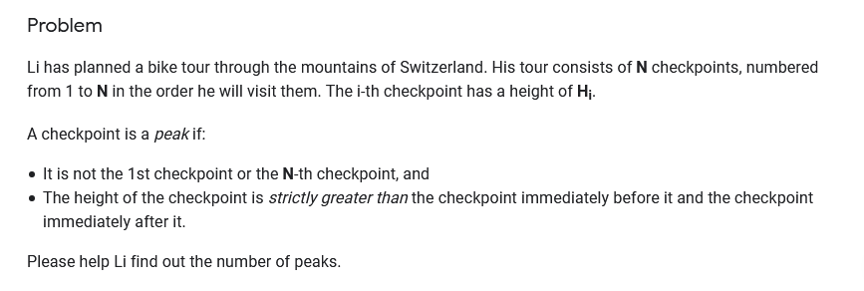
Problem Description

Slide 16
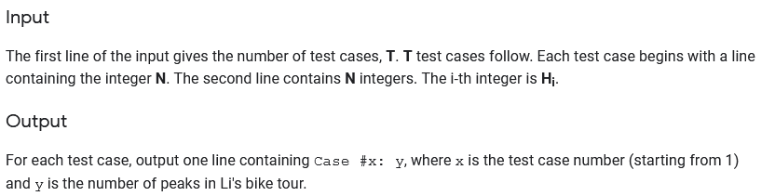
Input & Output

Slide 17
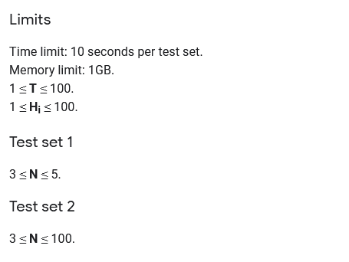
Limits for the subparts

Slide 18
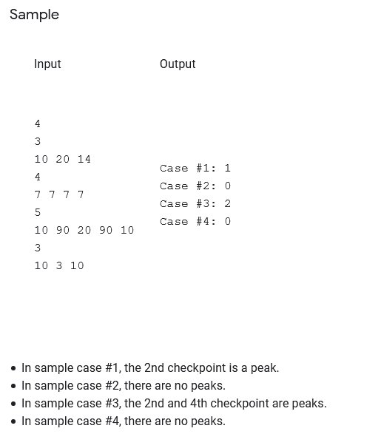
Sample Input & Output

Slide 19
Analysis
For each of the checkpoints, we can determine if it is a peak in O(1) time by comparing its height to the heights of the checkpoints before and after it.
There are N checkpoints, so the total time complexity of this approach is O(N), which is sufficient for both Test Set 1 and Test Set 2.

Slide 20
Solution
Input & Formatting of data
Algorithm
Output of Result

Slide 21
Kickstart 2020 Round C, Countdown
https://codingcompetitions.withgoogle.com/kickstart/round/000000000019ff43/00000000003380d2#problem

Slide 22
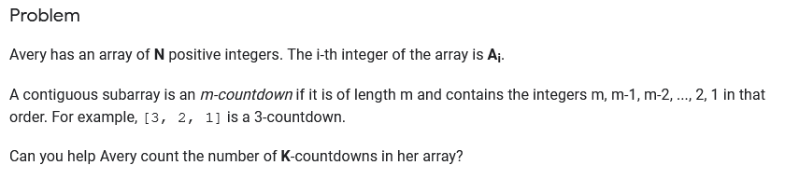
Problem description

Slide 23
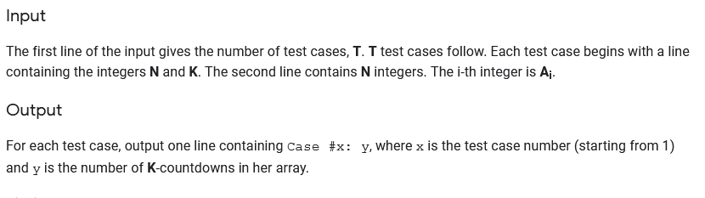
Input & Output

Slide 24
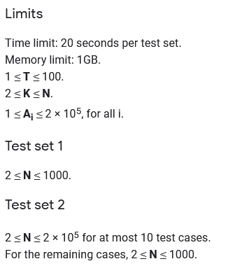
Requirement

Slide 25
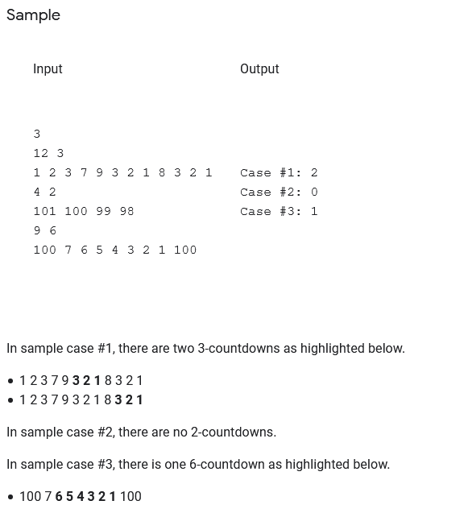
Sample with explanation

Slide 26
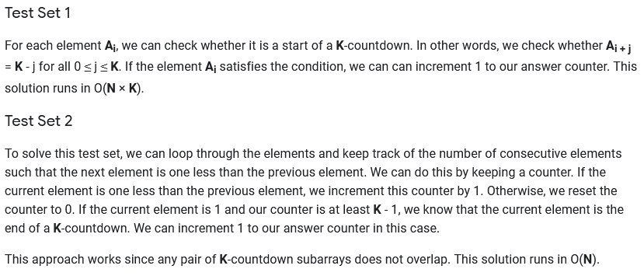
Analysis

Slide 27
Solution
Input & Formatting of data
Algorithm
Output of Result

Slide 28
Conclusion
The Qns are meant to be challenging
Focus not only on solving Qns, but also consider how many steps the program will repeat (e.g. no. of loops)

Slide 29
Thank you!

